Slide 1
Ecosystem Mural Components
Notes:
Teacher notes: This PPT can be printed (one-sided) to provide visual aids to the students as they do the mural activity, drawing and coloring organisms of the local ecosystem. This selection of organisms is not exhaustive, but it includes many prominent species that appeal to students. This PPT can also be running automatically in the background so that students can see other organisms in the ecosystem as the reproduce their own.

Slide 2
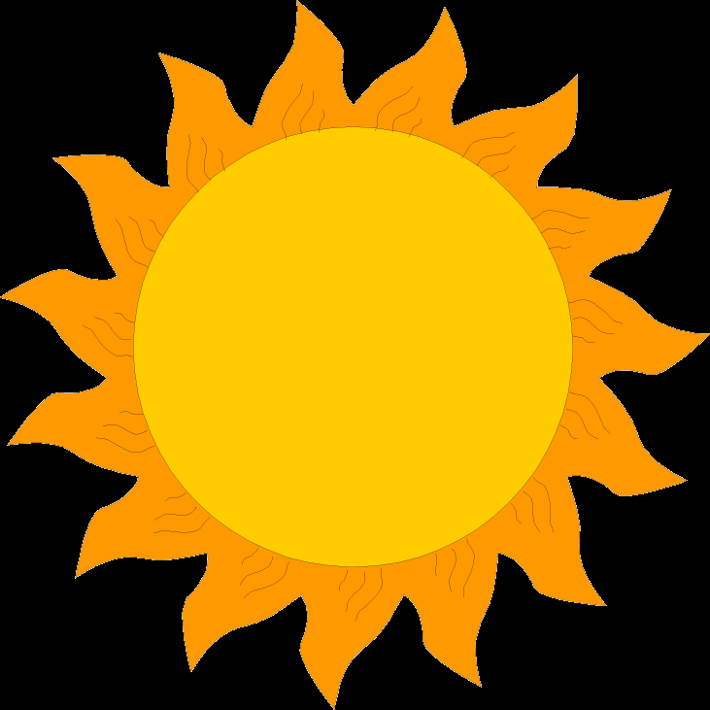
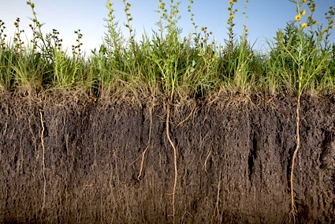
Above water – Nonliving
Sun (energy)
Soil
Carbon dioxide
Oxygen
CO₂
O₂

Slide 3
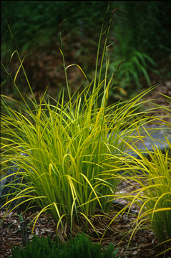
Above water – Living - Plants
Tussock sedge (Carex stricta)
Seeds are eaten by animals like cardinals, turkeys, mallards, wood ducks, and squirrels
It provides shelter for birds, turtles, toads, and mammals
When leaves die, they build up around the base of the plant, forming a “tussock,” or hill.

Slide 4
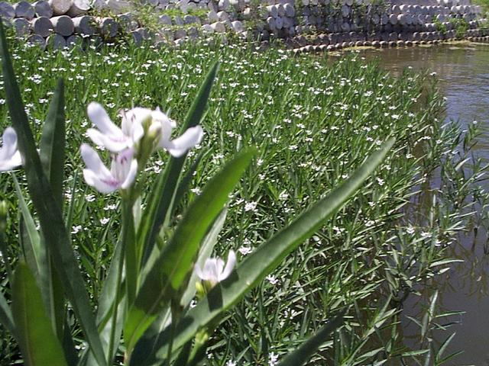
Above water – Living - Plants
American waterwillow (Justicia americana)
It provides food for deer, beaver, and muskrat.
Roots provide important spawning sites for fish (where fish lay their eggs).
When it decomposes, it provides food for benthic organisms.

Slide 5
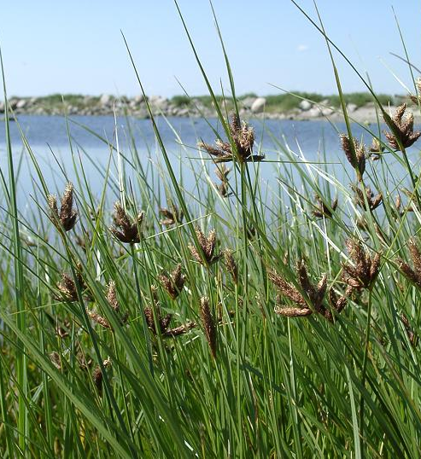
Above water – Living - Plants
River bulrush (Schoenoplectus fluvitalis)
The plant grows about five feet tall.
The thick sturdy stem was used in the past to build furniture.
Humans can eat the roots.

Slide 6
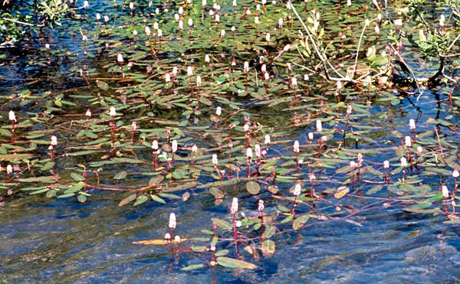
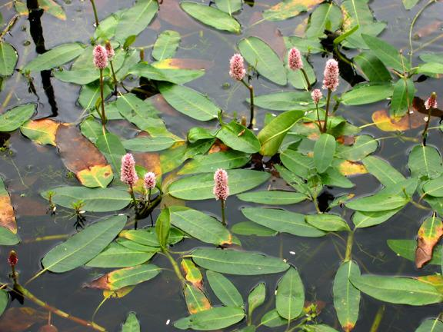
Above water – Living - Plants
Water smartweed (Polygnium amphibuium)
It was used by Native Americans as medicine and food.
The plant can grow easily both on land and in water.

Slide 7
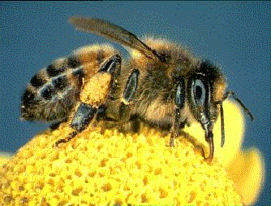
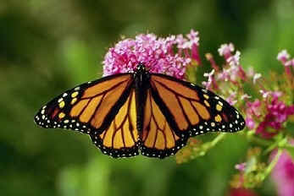
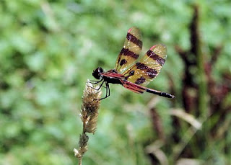
Above water – Living - Animals
Bugs like bees, butterflies, and dragonflies

Slide 8
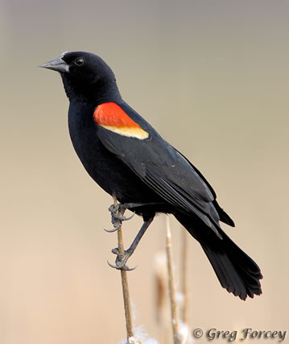
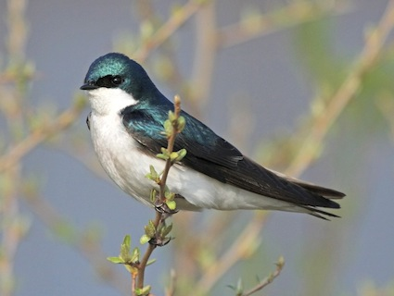
Above water – Living - Animals
Songbirds like red-winged blackbirds or tree swallows
Birds nest near water
Eat insects

Slide 9
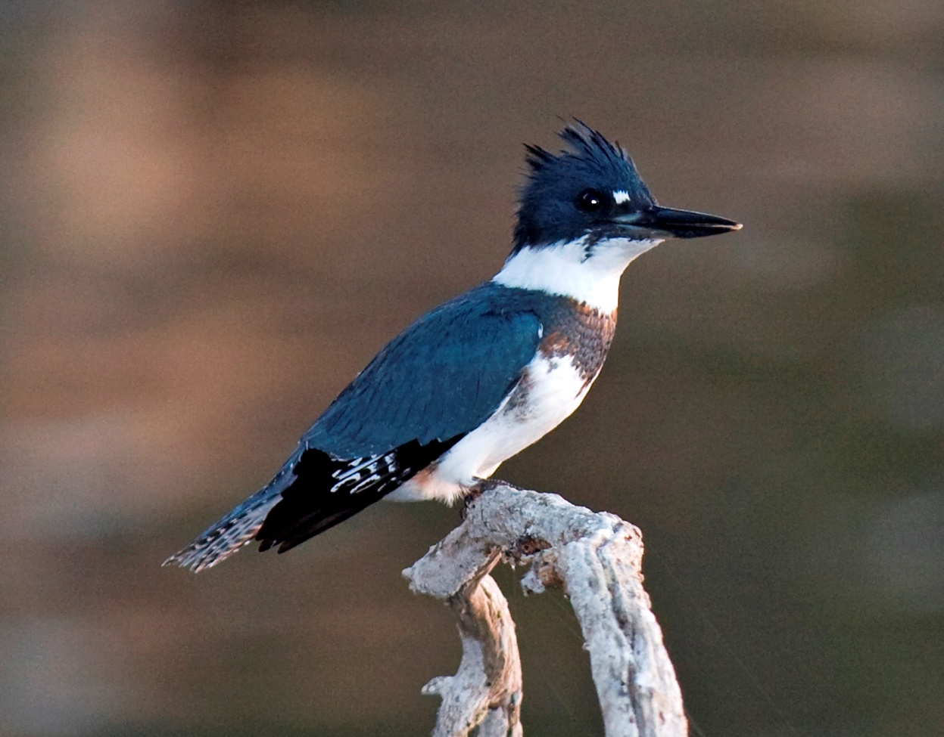
Above water – Living - Animals
Kingfisher
Medium bird that perches
Eats small fish

Slide 10
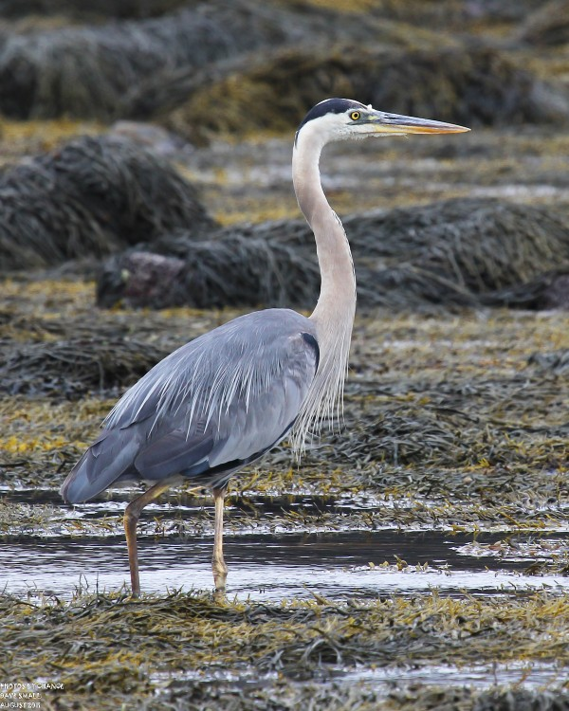
Above water – Living - Animals
Great blue heron
Large bird that wades
Eats small and medium fish

Slide 11
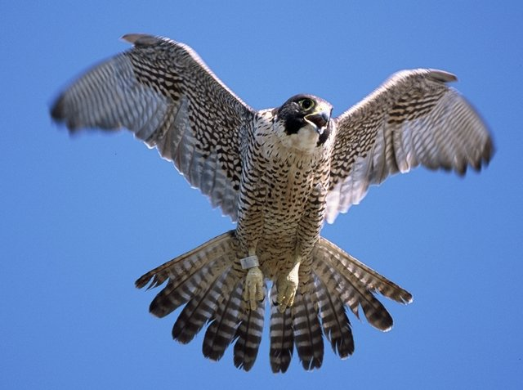
Above water – Living - Animals
Peregrine falcon
Medium bird that attacks prey from the sky
Eats small birds

Slide 12
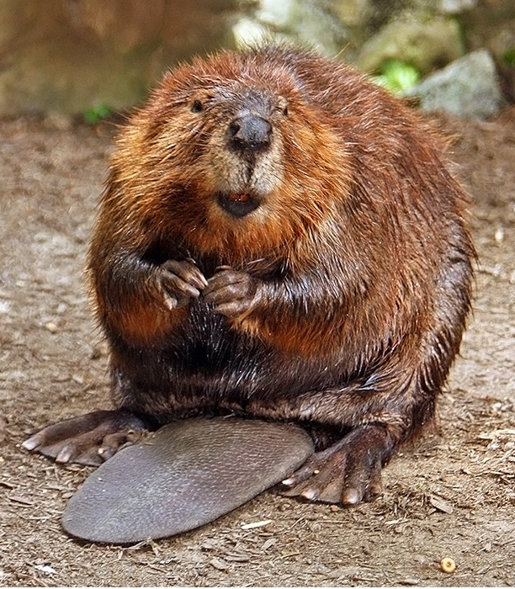
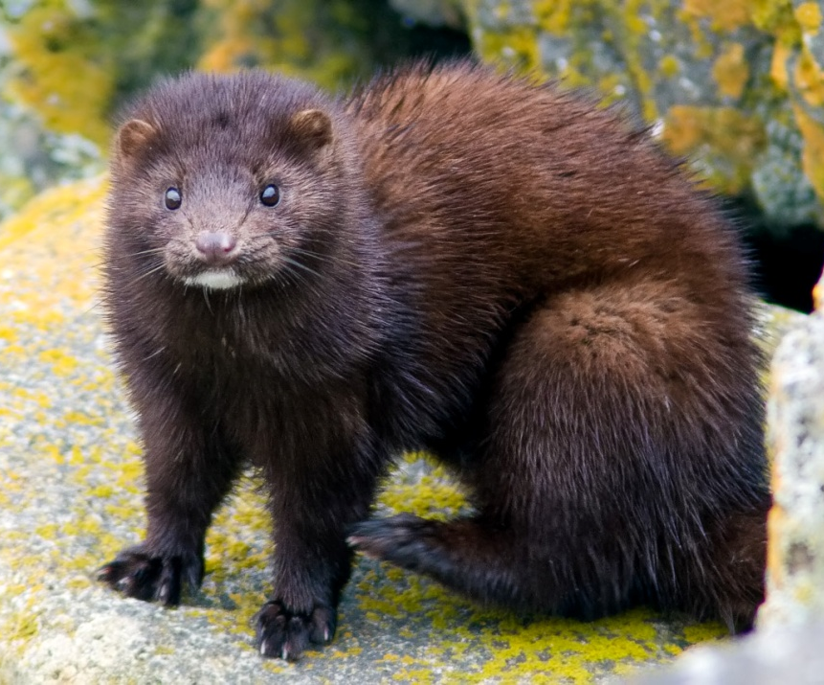
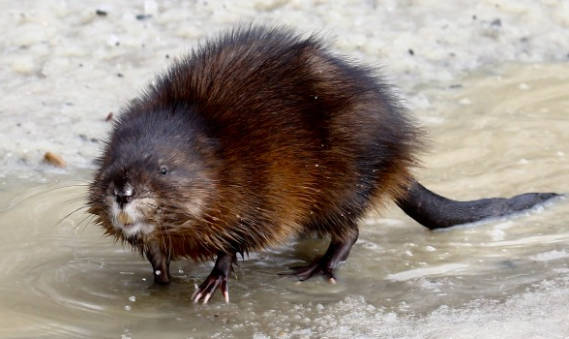
Above water – Living - Animals
Small mammals like mink, muskrat, & beaver
Eat fish and frogs

Slide 13
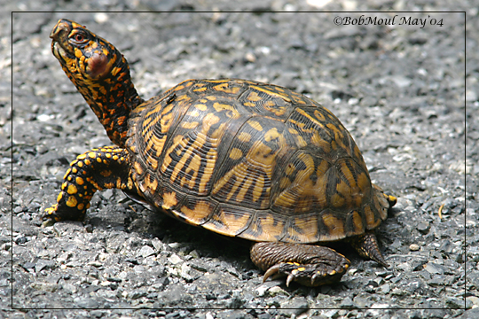
Above water – Living - Animals
Turtles
Eat vegetation and small animals

Slide 14
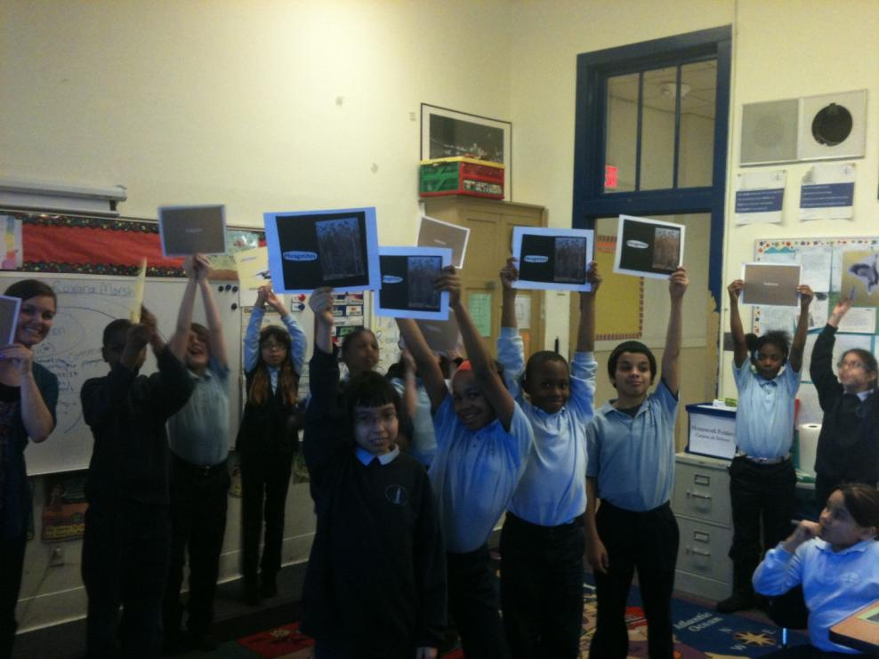
Above water – Living - Animals
People!

Slide 15
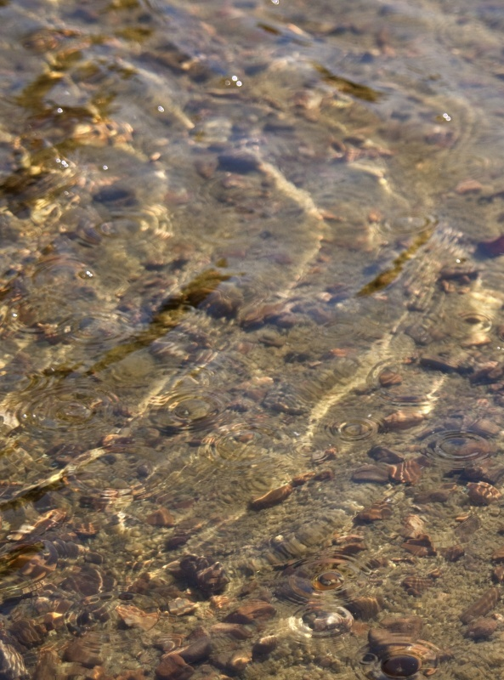
In the water – Nonliving
Sediment
Carbon dioxide
Oxygen
CO₂
O₂

Slide 16
In the water – Living - Plants
Water smartweed (Polygnium amphibuium)
It was used by Native Americans as medicine and food.
The plant can grow easily both on land and in water.

Slide 17
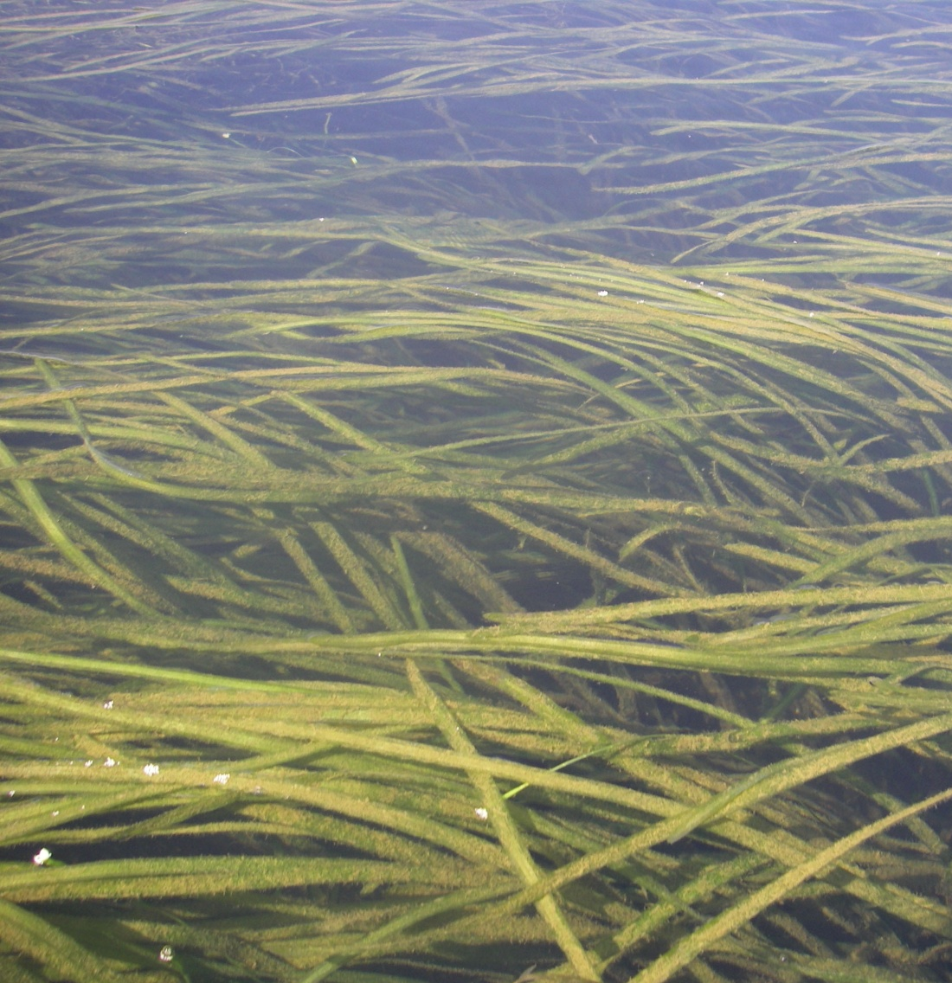
In the water – Living - Plants
Wild celery (Vallisneria americana)
The plant is a popular food for ducks, especially canvasbacks.
It provides important shelter for small fish and habitat for bugs that live in the water.

Slide 18
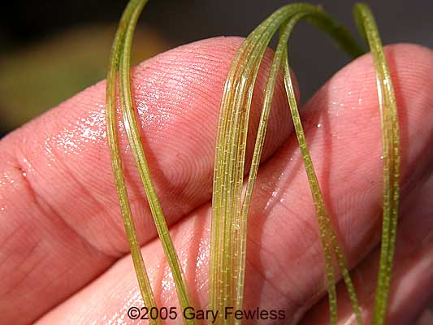
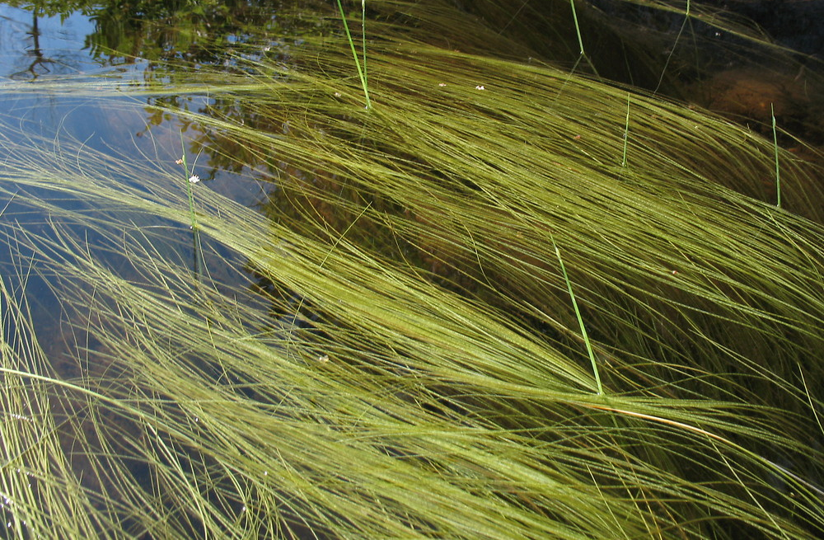
In the water – Living - Plants
Water bulrush (Schoenoplectus subterminalis)
The leaves are very thin and sway in the water, which is why it is also called swaying bulrush.
It grows very thickly, almost creating a mat of green in the river.

Slide 19
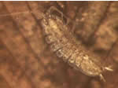
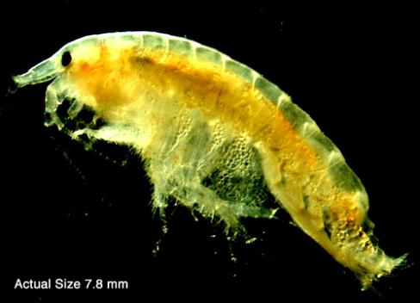
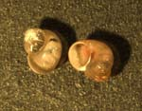
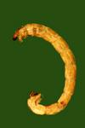
In the water – Living – Plants and Animals
Benthos
Small critters that live in the sediment

Slide 20
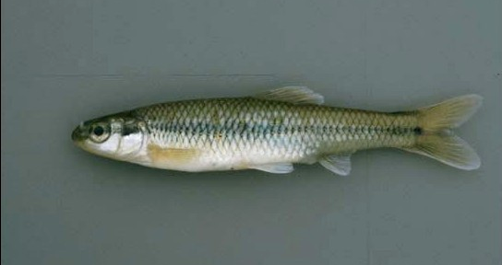
In the water – Living - Animals
Bluntnose Minnows
Small fish
Eats plants and benthic organisms

Slide 21
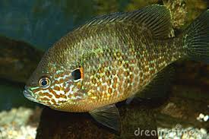
In the water – Living - Animals
Pumpkinseed
Medium fish
Eats benthic organisms and insects

Slide 22
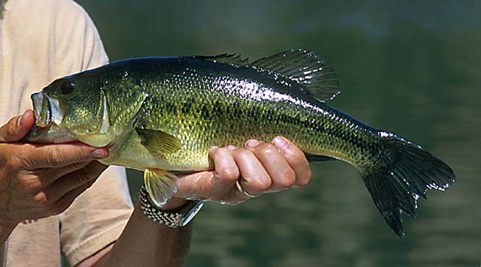
In the water – Living - Animals
Largemouth bass
Large fish
Eats small fish
Lays eggs in sediment

Slide 23
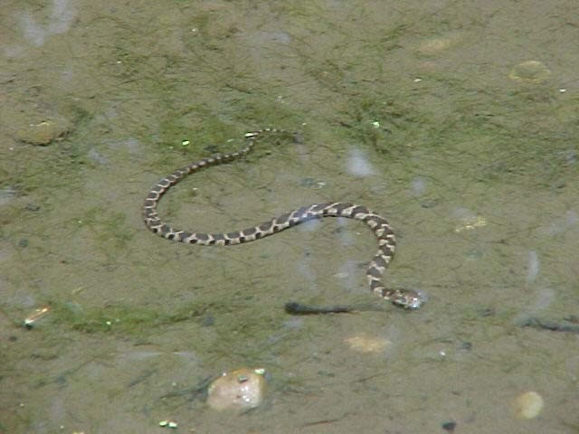
In the water – Living - Animals
Water snake
Reptile that lives in the water and eats animals

Slide 24
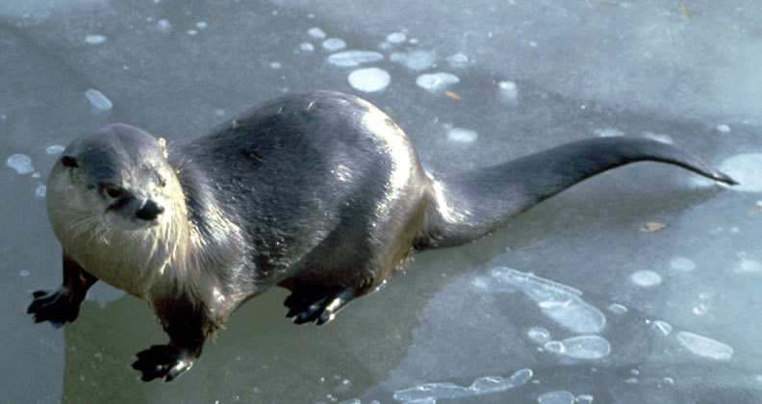
In the water – Living - Animals
River otter
Very playful mammal that loves to swim

